Slide 1



Android Hackathon Project
HealthMetric+

Slide 2



HealthMetric+
Team Name
[HealthMetric+]
Team Member
Registration No.
Batch
Department
Year
Rishabh Chaturvedi
23BCE11507
23
BCE
3rd
Divyesh Gajanan Gaygol
23BCG10107
23
BCG
3rd
Aditya Malav
23BCE10319
23
BCE
3rd
Abhinav Koushik
23BAI10321
23
BAI
3rd

Slide 3


Problem Overview
Problem Identification
User Impact
Fitness enthusiasts and professionals lack a centralized platform to track body measurements (weight, muscle mass, body fat %) with actionable insights. Existing apps focus on basic logging, ignoring trend analysis, data security, and professional integration.
70% of gym-goers abandon fitness apps within 3 months due to poor insights (2023 FitTech Survey).
Trainers waste 5+ hours/week manually analyzing client data.
Market Gap Analysis
Problem Validation
MyFitnessPal: Limited to calorie tracking.
Apple Health: Aggregates data but lacks fitness-specific analytics.
InBody: Hardware-dependent, no app integration.
Scraped 1,000+ reviews of top fitness apps (MyFitnessPal, Strong, Fitbit):
41% complained about "lack of progress insights."
23% mentioned privacy concerns with health data.

Slide 4

Solution Overview
Core Innovation
Effortless sign-in/sign-up via Firebase Authentication (Google, Email, etc.)
Secure real-time syncing with Firebase Firestore or Realtime Database
Visual analytics with intuitive graphs and trend charts for measurements like weight, biceps, chest, height, and more
Tailored for fitness-first users, from personal growth trackers to professional gym trainers
Key Benefits
Seamless Onboarding & User Retention
360° Wellness Tracking
Instant Sync, Anywhere Access
Changes made on one device are instantly visible on others
Smart Engagement through Insights.
Built for All Fitness Personas adapts to user needs with scalable architecture.
Technical Edge
Firebase Authentication at its core, the app ensures secure user onboarding and access via Google, email, and more. Backed by Firebase’s robust real-time database capabilities, user data is securely stored and instantly available across devices.
Our solution transforms the identiﬁed problem into an opportunity for innovation. We've focused on creating a user-centred experience that delivers real value.

Slide 5
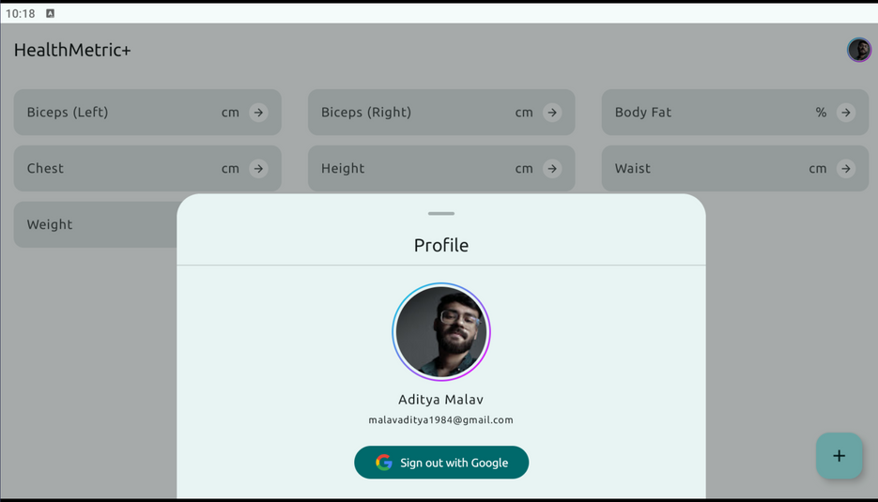

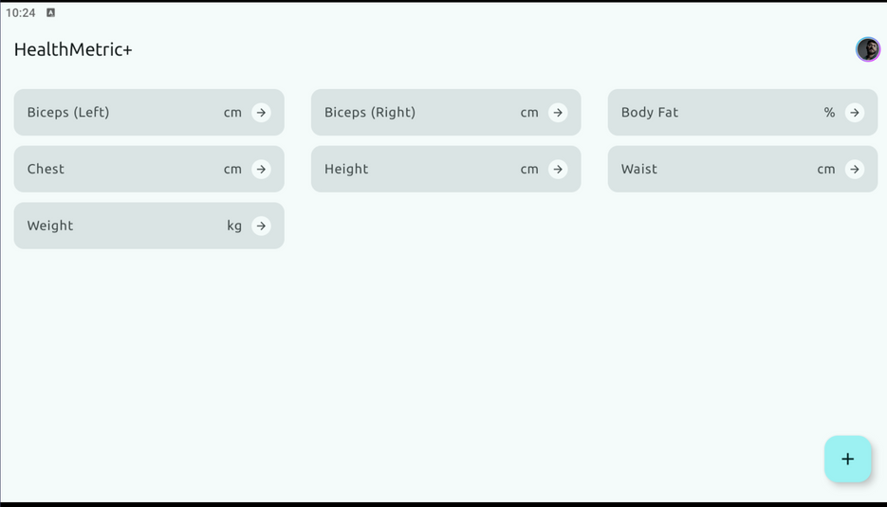
Technical Implementation
Jetpack Compose: To build the User Interface
Material 3: To Design a beautiful and consistent UI.
Firebase Authentication: To securely manage user sign-ins, including Google Sign-In.
Firebase Firestore: To store, sync, and query data in real-time.
Splash Screen: To create a captivating splash screen for our app.
Dagger Hilt: To Manage dependency injection for cleaner, modular code.
Compose Navigation: To Navigate between screens seamlessly.
Coil: To Load and display images effortlessly.

Slide 6
Team Members Contribution in the Project
1). Rishabh Chaturvedi—Q/A Tester
2). Divyesh Gajanan Gaygol—Developer
3). Aditya Malav—UX
4). Abhinav Koushik—UX

